Slide 1

Re-using public data to resolve the nature of ovarian cancer molecular subtypes
Levi Waldron, PhD.
CUNY School of Public Health
April 7, 2016

Slide 2
Overview
Meta-analysis of public data to assess:
prognostic signatures of ovarian cancer
molecular subtypes of ovarian cancer
Challenges and opportunities of using publicly available data
Batch effects
Sample duplication
The Gene Expression Omnibus (GEO)
The Cancer Genome Atlas (TCGA)

Slide 3
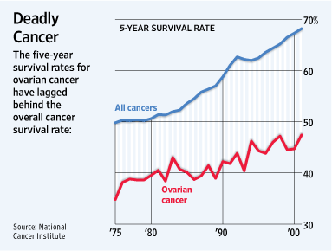
Slow progress in ovarian cancer outcomes
22,000 new cases each year
14,400 women die each year
Majority late-stage, high-grade, serous disease
Notes:
on ovarian cancer that encompasses all of these. Ovarian cancer is a major cause of mortality, and improvements in prognosis have lagged other cancers. One reason for this is that a majority of patients present with late-stage, high-grade, serous histology – this is a high-risk group with <50% 5-year survival, with little available from a clinical perspective to further refine prognosis.

Slide 4
Comparative meta-analysis: prognostic gene signatures of ovarian cancer Supervising learning of patient risk

Slide 5

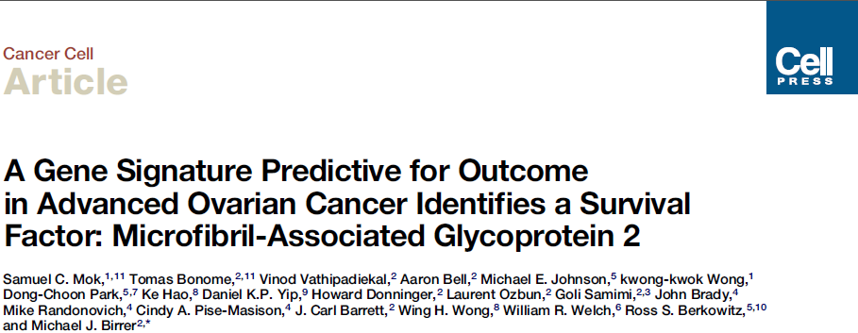
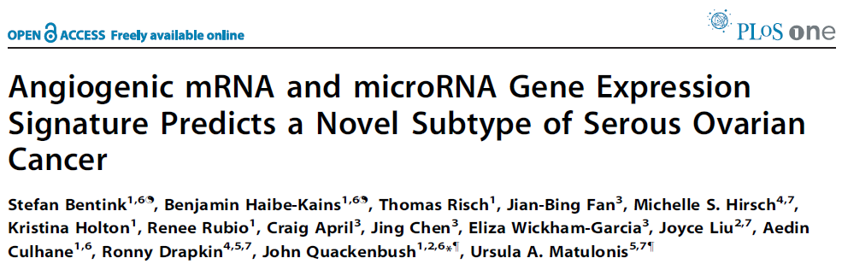
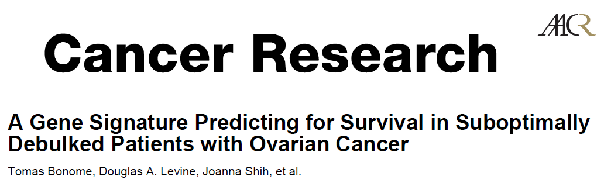

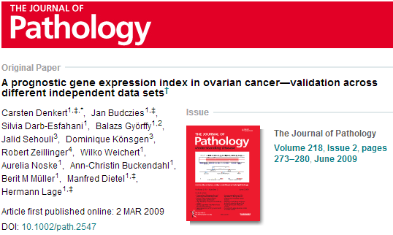

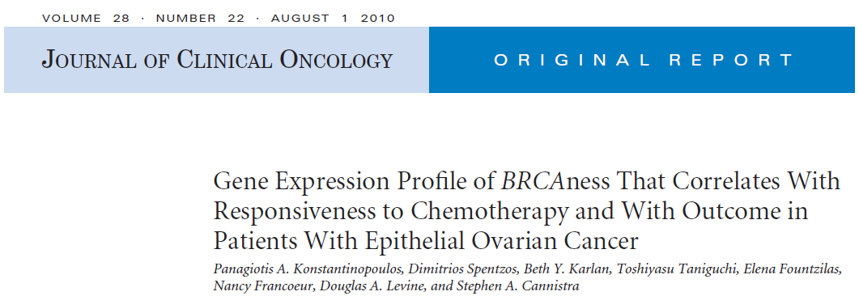
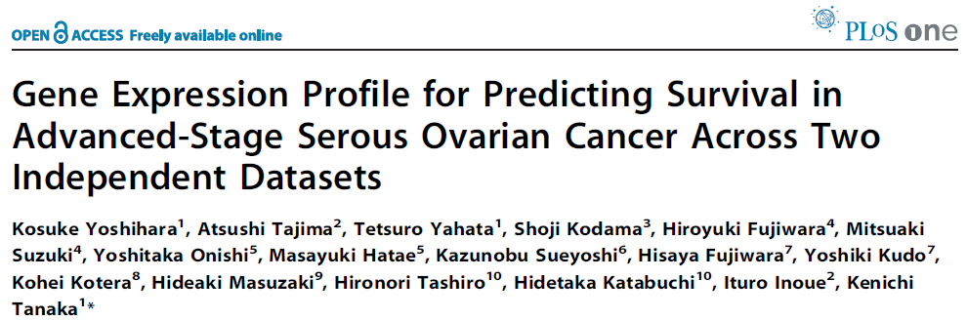
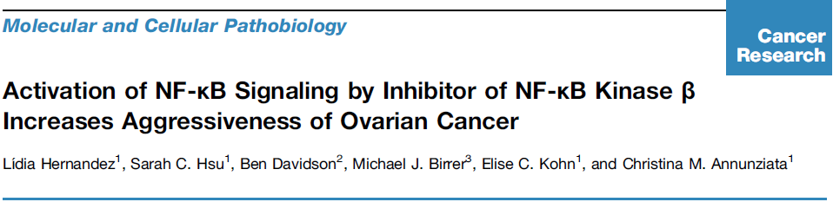

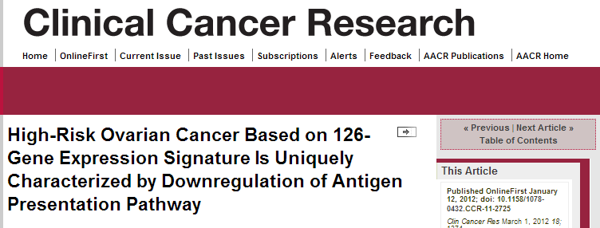

Comparative meta-analysis: prognostic gene signatures of ovarian cancer
Objectives:
Assess the reproducibility of published prognostic gene expression models
Evaluate published models using publicly available data
Improve on models using all publicly available data
Validate promising models in FFPE specimens from GOG-218 bevacizumab phase-III clinical trial
With Michael Birrer, MD (MGH)

Slide 6
Meta-analysis overview
Literature review
Prognostic models
curatedOvarianData
101 papers from Pubmed search
Five review papers
Standardized clinical annotation and gene ID
23 studies, 2,908 samples
Inclusion Criteria
Inclusion Criteria
Training sample size > 40
Focus on late-stage serous
Multivariate model
Continuous risk score
Claims to predict survival
Possible to reproduce model
Sample size > 40
Primary tumors
Overall survival available
Events (deaths) > 15
Late stage, high grade tumors
Serous subtype
14 prediction models implemented
100-page Sweave document
survHD Bioconductor package
10 datasets, 1,251 samples
Waldron L et al. JNCI J Natl Cancer Inst 2014;jnci.dju049
Notes:
The meta-analysis itself borrows ideas from the traditional meta-analysis that synthesizes results of independent clinical trials or health studies, but differs in some important ways. It similarly begins with a systematic literature review based on defined search terms and time period plus review papers. Inclusion and exclusion criteria are defined precisely to limit the search to plausible and relevant prognostic signatures, claiming to be prognostic for late-stage serous disease, providing risk predictions on a continuous scale and based on enough samples to be plausible. This final point is an important one, we had to be able to reproduce the model sufficiently to be able to apply it to new datasets, and this is very different from a traditional meta-analysis which would be considering for example a single treatment, rather than an algorithm. This search resulted in 14 prognostic signatures, representing the major efforts to refine prognosis and understand the biological basis of prognosis for ovarian cancer over the past 5 years. We documented exactly how each model was reproduced, and provided evidence of the faithfulness of our re-implementation by reproducing published results, in a 100-page document showing methods and results for all 14 signatures. We also had to create a framework in which to implement these models consistently, and use them to make predictions with new data, which resulted in the survHD package.
I already described the database, which allowed creation of simple filter rules to narrow the database to the late-stage, high-grade samples we are interested in, with overall survival known and in sufficient sample size, providing nearly 1,500 samples from 10 studies. It’s worth pointing out that this is almost three times the number of samples available from the largest ovarian cancer study to date, the multi-million dollar Cancer Genome Atlas consortium project.

Slide 7
Reproducibility of published models
Model | Reproducibility
 | Model Provided | Training Data Available | Validation Data Available | Verified Implementation
TCGA11 [12] | YES | YES | YES | YES
Denkert09 [13] | YES | YES | YES | YES
Bonome08_263genes [14] | YES | YES | YES | YES
Bonome08_572genes [14] | YES | YES | YES | YES
Mok09 [15] | NO | YES | YES | PARTIALLY
Yoshihara12 [16] | YES | - | YES | YES
Yoshihara10 [17] | YES | - | YES | YES
Bentink12 [18] | YES | - | YES | YES
Kang12 [19] | YES | YES | YES | PARTIALLY
Crijns09 [20] | NO | YES | NO | NO
Kernagis12 [21] | PARTIALLY | YES | YES | PARTIALLY
Sabatier11 [22] | PARTIALLY | NO | NO | NO
Konstantinopoulos10 [23] | YES | - | YES | PARTIALLY
Hernandez10 [24] | PARTIALLY | - | YES | PARTIALLY
Table 1. Reproducibility of the 14 published models for prognosis of late-stage epithelial ovarian cancer selected for meta-analysis

Slide 8
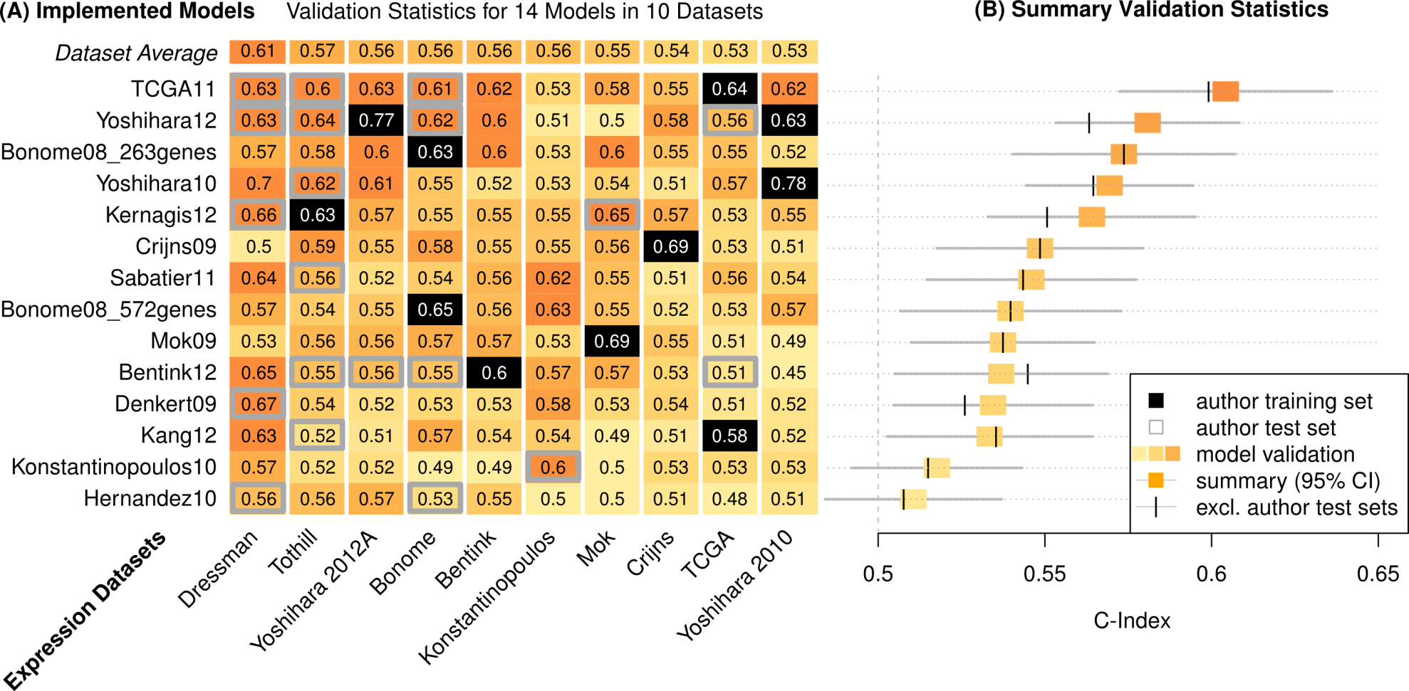
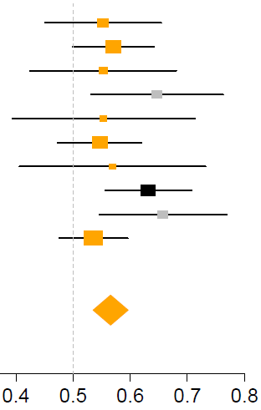
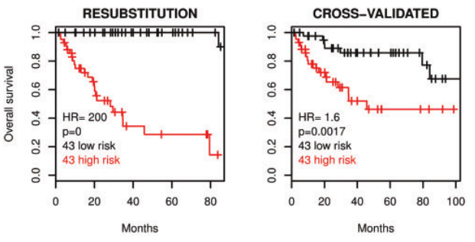
Assessment of prognostic models
Validation Statistics:
14 Models in 10 Datasets
C-Index = Pr(g(Z₁)>g(Z₂) | T₂>T₁)
T₁, T₂ = times to death of two patients
g(Z₁), g(Z₂) = predicted risk scores
C=0.5 expectation for random prediction
C=1 if the exact order of all deaths is predicted
14 prognostic signatures
Forest plot
Kaplan-Meier estimate
Study
Survival
10 microarray datasets
C-Index
Time
Waldron L et al. JNCI J Natl Cancer Inst 2014;jnci.dju049

Slide 9
Assessment of prognostic models
Validation Statistics:
14 Models in 10 Datasets
14 prognostic signatures
10 microarray datasets
Waldron L et al. JNCI J Natl Cancer Inst 2014;jnci.dju049

Slide 10
Assessment of prognostic models
Validation Statistics:
14 Models in 10 Datasets
Cancer Genome Atlas Research Network. Integrated genomic analyses of ovarian carcinoma. Nature 474, 609–615 (2011).
Yoshihara, K. et al. High-risk ovarian cancer based on 126-gene expression signature is uniquely characterized by downregulation of antigen presentation pathway. Clin. Cancer Res. 18, 1374–1385 (2012).
Bonome, T. et al. A gene signature predicting for survival in suboptimally debulked patients with ovarian cancer. Cancer Res. 68, 5478–5486 (2008).
Yoshihara, K. et al. Gene expression profile for predicting survival in advanced-stage serous ovarian cancer across two independent datasets. PLoS One (2010).
Crijns, A. P. G. et al. Survival-related profile, pathways, and transcription factors in ovarian cancer. PLoS Med. 6, e24 (2009).
14 prognostic signatures
10 microarray datasets
Waldron L et al. JNCI J Natl Cancer Inst 2014;jnci.dju049

Slide 11
Assessment of datasets
Validation Statistics:
14 Models in 10 Datasets
Dressman et al. J Clin Oncol. 2007 25(5):517-25. An integrated genomic-based approach to individualized treatment of patients with advanced-stage ovarian cancer.
14 prognostic signatures
Baggerly et al. J Clin Oncol. 2008 26(7):1186-7. Run batch effects potentially compromise the usefulness of genomic signatures for ovarian cancer.
Dressman et al. J Clin Oncol. 2012 30(6):678. Retraction.
10 microarray datasets
Waldron L et al. JNCI J Natl Cancer Inst 2014;jnci.dju049

Slide 12
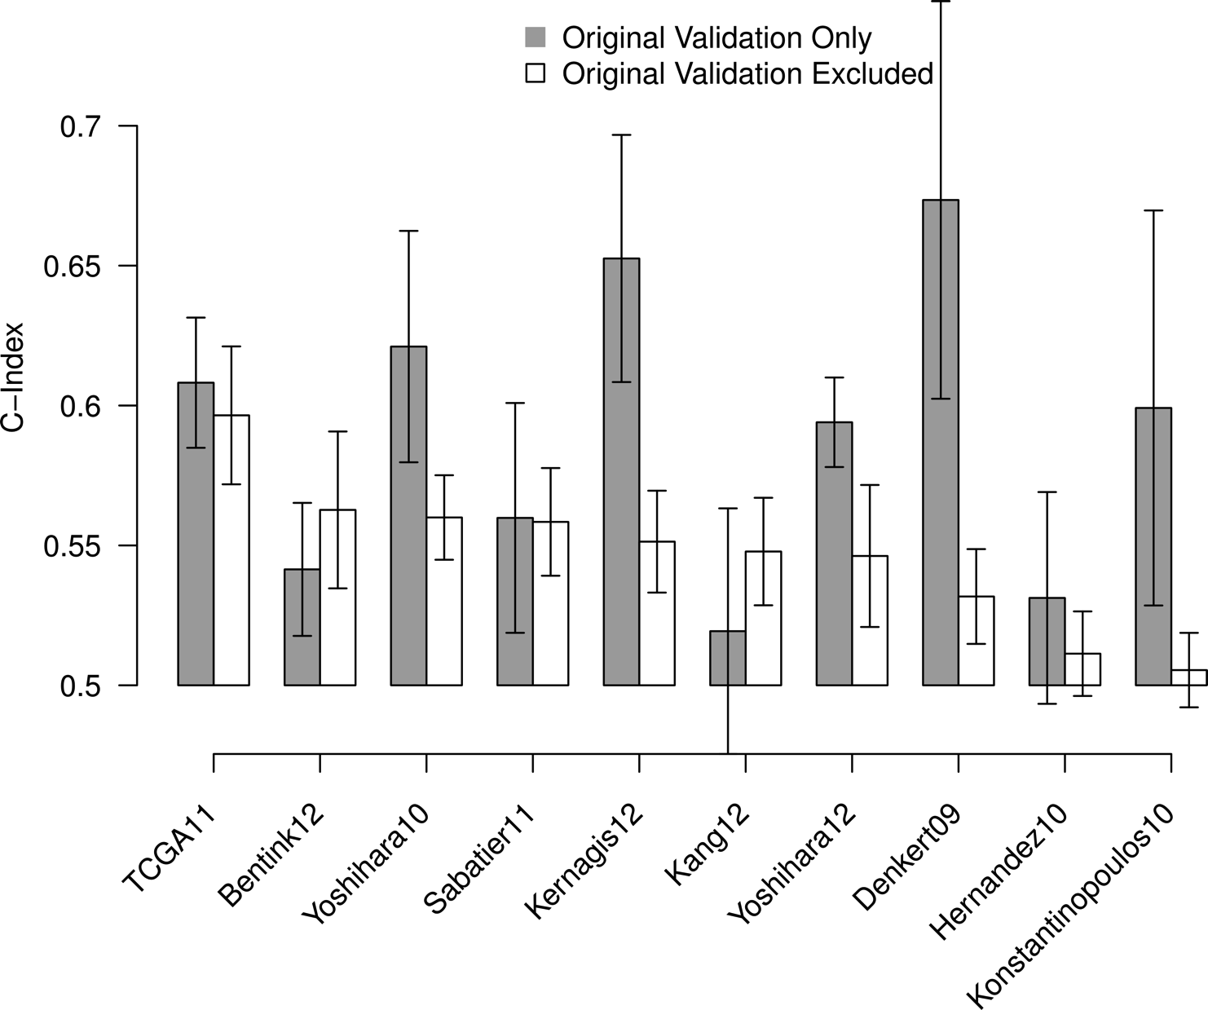
Influence of validation set choice
Waldron L et al. JNCI J Natl Cancer Inst 2014;jnci.dju049

Slide 13
Assessment of gene signatures (not models)
Start with a signature defined as a list of genes
Fit a simple prediction algorithm (β = ±1)
Compute “leave-one-in” matrix of C-statistics
Repeat with random gene sets
Dataset #
 | 1 | 2 | 3 | 4 | 5
1 | TRAIN | TEST | TEST | TEST | TEST
2 | TEST | TRAIN | TEST | TEST | TEST
3 | TEST | TEST | TRAIN | TEST | TEST
4 | TEST | TEST | TEST | TRAIN | TEST
5 | TEST | TEST | TEST | TEST | TRAIN
Iteration #
Notes:
We were interested not just in assessing fully-specified prediction algorithms, but the genes used by those algorithms. Sometimes all we care about are the predictions, but often, a lot of effort goes into thinking hard about those genes and coming up with a biological explanation of why they work so well in this prediction algorithm. But the fact is, there are situations where you can make OK predictions from random gene sets, so the objective here was to use all the datasets for independent validation and assess these gene signatures. So the procedure was:
Summarize prognostic quality of a gene list by its average C-statistic for off-diagonal elements in this matrix of validation statistics

Slide 14
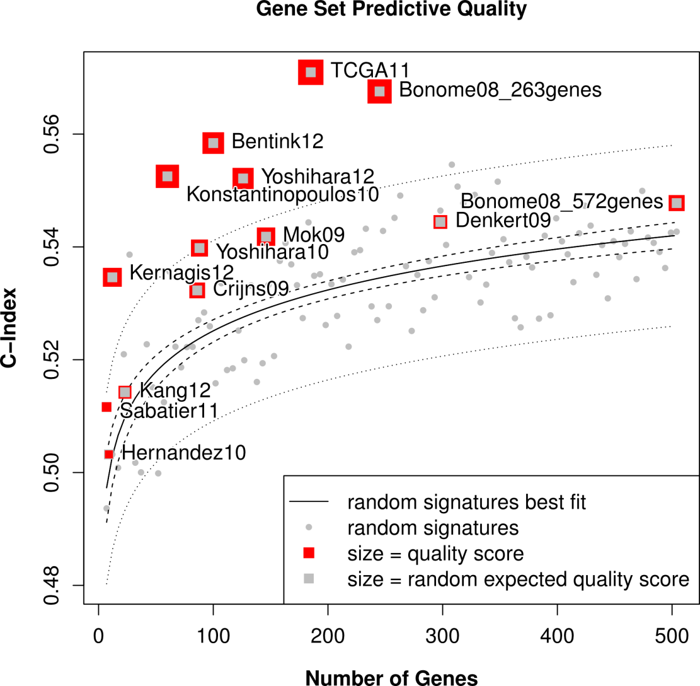
Assessment of gene signatures
About half of gene signatures provide prognostic “value added” over 97.5% of gene random signatures
Waldron L et al. JNCI J Natl Cancer Inst 2014;jnci.dju049
Notes:
What I show here is the mean C-statistic across all combinations of training and independent validation sets, as a function of the number of genes in the signature.

Slide 15
“Leave-one-in/out” independent validation
Leave-one-in: train using each single dataset in turn, test on the rest:
simulatorZ Bioconductor package
Zhang Y, Bernau C, Parmigiani G, Waldron L:. Dataset heterogeneity in the validation of prediction models across studies. (in preparation)
Trippa L, Waldron L, Huttenhower C, Parmigiani G: Bayesian nonparametric cross-study validation of prediction methods. Ann. Appl. Stat. 2015, 9:402–428.
Bernau C, Riester M, Boulesteix A-L, Parmigiani G, Huttenhower C, Waldron L*, Trippa L*: Cross-study validation for the assessment of prediction algorithms. Bioinformatics 2014, 30:i105–12.
Zhao SD, Parmigiani G, Huttenhower C, Waldron L: Más-o-menos: a simple sign averaging method for discrimination in genomic data analysis. Bioinformatics 2014, 30:3062–3069.

Slide 16
“Leave-one-in/out” independent validation
Leave-one-out: train using all but one dataset, test on the one remaining:
Dataset #
 | 1 | 2 | 3 | 4 | 5
1 | TEST | TRAIN | TRAIN | TRAIN | TRAIN
2 | TRAIN | TEST | TRAIN | TRAIN | TRAIN
3 | TRAIN | TRAIN | TEST | TRAIN | TRAIN
4 | TRAIN | TRAIN | TRAIN | TEST | TRAIN
5 | TRAIN | TRAIN | TRAIN | TRAIN | TEST
Iteration #

Slide 17
“Leave-one-in/out” independent validation
Leave-one-out: train using all but one dataset, test on the one remaining:
Riester M et al.: Risk prediction for late-stage ovarian cancer by meta-analysis of 1525 patient samples. J. Natl. Cancer Inst. 2014, 106.
Pasolli E, Truong DT, Malik F, Waldron L, Segata N: Machine learning meta-analysis of large metagenomic datasets: tools and biological insights (in review).

Slide 18
Clinical relevance of molecular subtypes of ovarian cancer
Unsupervised learning of biological subtypes
with Haibe-Kains lab, University of Toronto

Slide 19
Subtyping methods
Citation | Probe / gene filtering for Clustering | Clustering Algorithm | Number of Clusters | Probe / gene filtering for Classification | Subtype Classifier
Tothill et al., 2008 (Clin Cancer Res) Helland et al., 2011 (PLoS One) | Probes with at least one sample expressed above 7.0, and global variance above 0.5 | Consensus k-means; diagonal LDA and kNN | 4 | Gene ranking by differentially expressed genes between groups | Linear subtype scores
TCGA, 2011 (Nature) Verhaak et al., 2012 (J Clin Invest) | Filter to genes that correlate above 0.7 between three platforms to unified estimate; then take top 1500 genes by median absolute deviation (MAD) | Non-negative Matrix Factorization | 4 | Filter patients by silhouette width; correlation-based feature subset selection | Single-sample Gene Set Enrichment Analysis
Konecny et al., 2014 (J Natl Cancer Inst) | Top 2500 probes by MAD, then keep 1850 unique gene symbols | Non-negative Matrix Factorization | 4 | Prediction Analysis of Microarrays with thresholds determined by 10-fold cross validation | Nearest Centroid with Spearman’s rho
Objectives:
Assess the reproducibility of published subtyping algorithms
Evaluate subtypes using publicly available data
Establish the likely chronology of subtype evolution
Differences in patients, microarray technologies, gene expression normalization, probe-gene mapping, feature selection, clustering algorithm, and classification algorithm

Slide 20
Meta-analysis of ovarian cancer subtypes
Methods:
Read published descriptions of subtype classification algorithms
Implement complex subtype definitions as open-source algorithms in R
Generate validation datasets from GEO
Assess subtype definitions and compare to original publication

Slide 21
Subtyping methods
Citation | Probe / gene filtering for Clustering | Clustering Algorithm | Number of Clusters | Probe / gene filtering for Classification | Subtype Classifier
Tothill et al., 2008 (Clin Cancer Res) Helland et al., 2011 (PLoS One) | Probes with at least one sample expressed above 7.0, and global variance above 0.5 | Consensus k-means; diagonal LDA and kNN | 4 | Gene ranking by differentially expressed genes between groups | Linear subtype scores
TCGA, 2011 (Nature) Verhaak et al., 2012 (J Clin Invest) | Filter to genes that correlate above 0.7 between three platforms to unified estimate; then take top 1500 genes by median absolute deviation (MAD) | Non-negative Matrix Factorization | 4 | Filter patients by silhouette width; correlation-based feature subset selection | Single-sample Gene Set Enrichment Analysis
Konecny et al., 2014 (J Natl Cancer Inst) | Top 2500 probes by MAD, then keep 1850 unique gene symbols | Non-negative Matrix Factorization | 4 | Prediction Analysis of Microarrays with thresholds determined by 10-fold cross validation | Nearest Centroid with Spearman’s rho
Reproducibility of proposed subtypes is good!

Slide 22
Creating useful unsupervised classifiers
Unsupervised learning: group observations into “subtypes”
Supervised learning: create a classifier to assign new cases to a subtype
Set of all possible cancer samples X
New sample
Unlabelled data:
x₁, x₂, …, x_{N}
Unsupervised learning
(clustering)
Labelled data:
(x₁, y₁), (x₂, y₂), …,
(x_{N}, y_{N})
Supervised learning
Classifier
Select number of clusters k
Predicted class

Slide 23
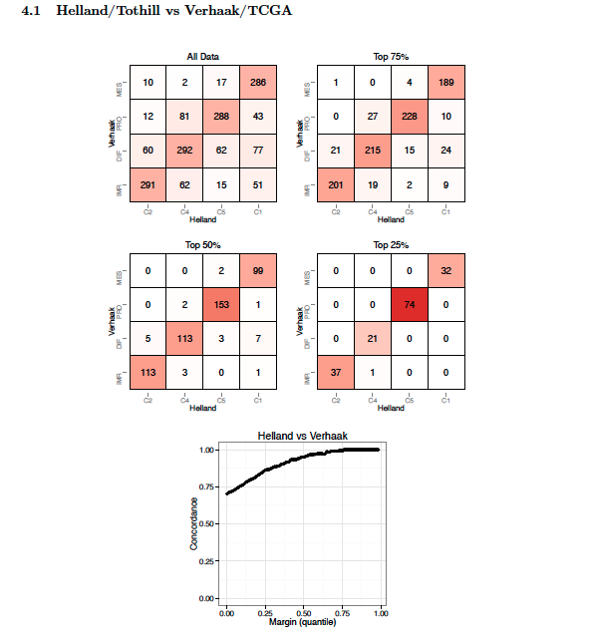
Proposed subtypes have a lot in common!
Top left: contingency table of two 4-subtype schemes
Other panels: removal of “marginal” calls
Bottom: Concordance vs. # marginal calls removed
Summary: except for “marginal cases”, different subtyping algorithms are highly similar

Slide 24
Facilitating re-use of publicly available data Work on GEO and TCGA

Slide 25
Gene Expression Omnibus (GEO)
A public repository for the archiving and distribution of gene expression data submitted by the scientific community.
Online resource for gene expression data browsing, query, analysis and retrieval.
Convenient deposition of gene expression data, as required by funding agencies and journals.
A bit of a “Dropbox” for your data

Slide 26
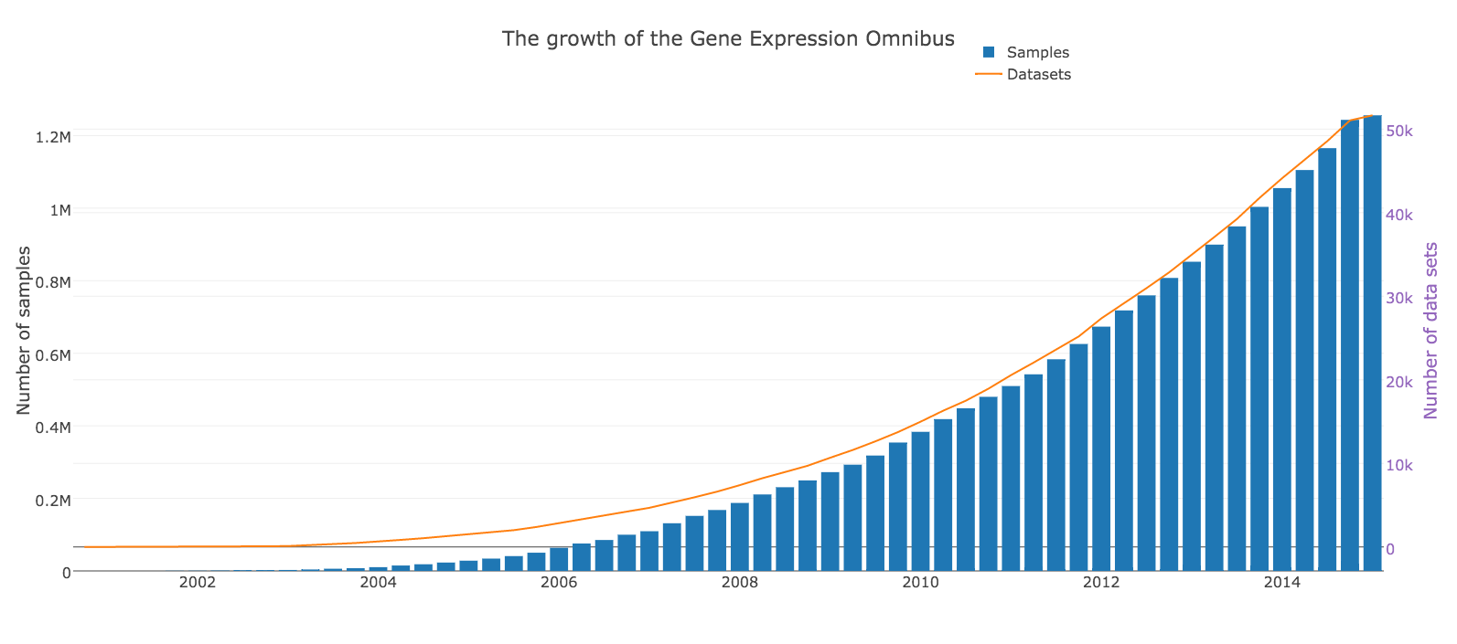
Growth of GEO
Creative Commons image from https://plot.ly/34/~sambucas/

Slide 27
Using GEO for meta-analysis
25 curated ovarian cancer gene expression datasets
3,500 patients
Original cost ~ $500 / microarray
New cost: ~1 year of curation and “data wrangling”

Slide 28
Using GEO to understand the biology of health disparities in prostate cancer
Racial/Ethnic Group | Incidence | Death
All | 168 | 27.9
African American/Black | 255.5 | 62.3
Asian/Pacific Islander | 96.5 | 11.3
Hispanic/Latino | 140.8 | 21.2
American Indian/Alaska Native | 68.2 | 21.5
White | 161.4 | 25.6
Prostate Cancer Incidence and Death Rates. Statistics are for 2000-2004, age-adjusted to the 2000 U.S. standard million population, and represent the number of new cases of invasive cancer (1) and deaths (2) per year per 100,000 men.
Source: Surveillance, Epidemiology, and End Results (SEER) Program (http://www.seer.cancer.gov)
Peter Chernek,
MPH candidate

Slide 29
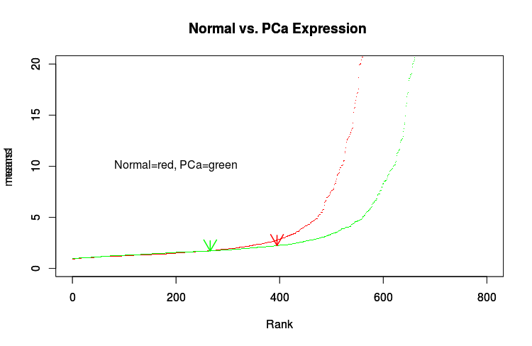
Using GEO to understand the biology of health disparities in prostate cancer
Dataset GSE40026: Expression profiling of prostate cell lines by miRNA array
(934 miRNA profiled)
Mean expression of all miRNA
miRNA-1207-3p
Rank
Collaborator: Olorunseun Ogunwobi, MD, PhD Hunter College

Slide 30
23 ovarian cancer microarray studies
Machine syntax check
CURATION
ID | Debulk | Status | …
D2640 | S | 0
sampleid | debulking | vital_status | …
D2640 | suboptimal | living
✔
ID | ch1.3 | Status | …
GSM123 | opt | DOD
sampleid | debulking | vital_status | …
GSM123 | optimal | deceased
✔
Human double check
Download expression data
Affymetrix
platform
Y
Y
(f) RMA re-normalization
Raw data?
N
N
Collapse probesets to genes
Probeset | Gene | GSM123 | GSM124
204531_s_at | BRCA1 | 4.0 | 4.1
211851_x_at | BRCA1 | 5.0 | 6.0
Gene | GSM123 | GSM124
BRCA1 | 5.0 | 6.0
Automatically build documented curatedOvarianData R package
B.F. Ganzfried et al. curatedOvarianData: Clinically Annotated Data for the Ovarian Cancer Transcriptome. DATABASE (Oxford) 2013, 10.1093/database/bat013
Notes:
We created a curated database of ovarian cancer microarray studies, which formed the basis for this meta-analysis and also spurred several statistical methodology projects. We identified 23 potentially relevant studies with clinically-annotated microarray data. <click> The clinical data had to be manually curated to enable across-study analyses. For this we created a template that could be edited by ovarian cancer experts, that was directly used for formal syntax validation. Important datasets were curated independently by two people, and the results checked against each other for accuracy. <click> All of this is performed by an automated pipeline, and the next step is fetching and processing of the microarray data from a variety of public databases, <click> then mapping platform-specific identifiers to standard gene symbols. Finally this is wrapped up as the curatedOvarianData package for R/Bioconductor, and I believe represents both the most highly-curated database for any cancer, and the first to be packaged in such a statistician-friendly manner. This database made it *easy* to perform meta-analyses and as a result not only enabled the initial goals of this project but a great deal of methodological development.

Slide 31
curated*Data Bioconductor packages
curatedOvarianData
30 datasets, > 3K unique samples
most annotated for OS, surgical debulking, histology...
curatedCRCData
34 datasets, ~4K unique samples
many annotated for MSS, gender, stage, age, N, M
curatedBladderData
12 datasets, ~1,200 unique samples
many annotated for stage, grade, OS
Coming: curatedMetagenomicData
with Edoardo Pasolli, Nicola Segata

Slide 32
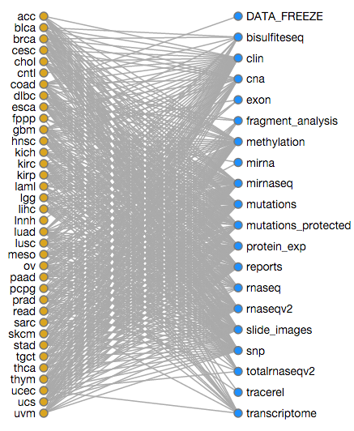
The Cancer Genome Atlas
Comprehensive genomic profiling of 36 cancer types
More than 12 genomic data types for each cancer
Clinical, pathological, demographic data

Slide 33
The Cancer Genome Atlas
Objectives
Design an integrative data representation for multi-omics experiments
MultiAssayExperiment 1 week old in Bioconductor
Ease the burden of “data wrangling”
109295 files, 2.34 PB of data
Multiple types and “levels” of clinical, pathological, demographic data, with follow-up visits

Slide 34
The Cancer Genome Atlas
> library(MultiAssayExperiment)
> load("ovMAEO.Rda")
> ovMAEO
A "MultiAssayExperiment" object of 8 listed
experiments with user-defined names and respective classes.
Containing an "Elist" class object of length 8:
[1] RNASeq2GeneNorm: "ExpressionSet" - 20501 rows, 83 columns
[2] miRNASeqGene: "ExpressionSet" - 705 rows, 85 columns
[3] CNASNP: "RangedRaggedAssay" - 100673 rows, 167 columns
[4] CNVSNP: "RangedRaggedAssay" - 34146 rows, 167 columns
[5] CNACGH: "RangedRaggedAssay" - 44241 rows, 166 columns
[6] Methylation: "ExpressionSet" - 27578 rows, 85 columns
[7] mRNAArray: "ExpressionSet" - 18632 rows, 85 columns
[8] miRNAArray: "ExpressionSet" - 821 rows, 85 columns
To access slots use:
Elist() - to obtain the "Elist" of experiment instances
pData() - for the primary/phenotype "DataFrame"
sampleMap() - for the sample availability "DataFrame"
metadata() - for the metadata object of 'ANY' class
See also: subsetByAssay(), subsetByRow(), subsetByColumn()
>

Slide 35
Sample duplication The doppelgänger effect

Slide 36
doppelgangR: identifying duplicate samples in genomic databases
The problem: GEO etc provide many useful gene expression datasets, but samples get duplicated:
Labs publish multiple papers from the same or slightly modified patient cohorts
Generous labs share specimens with other labs or consortial projects
Duplicates may be on the same or different microarray / RNA-seq platforms
Waldron L, Riester M, Ramos M, Parmigiani G, Birrer M: The doppelgänger effect: hidden duplicates in databases of transcriptome profiles. (JNCI, in press)

Slide 37
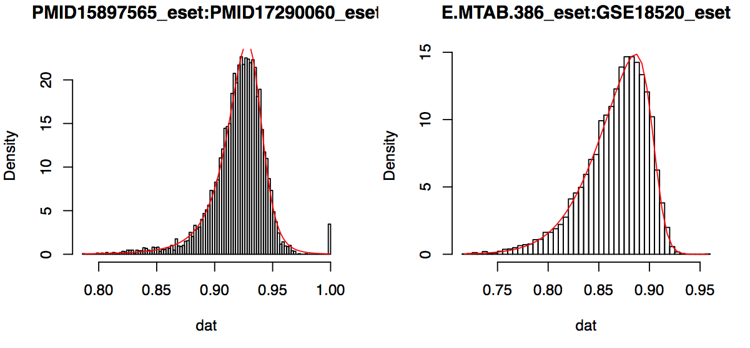
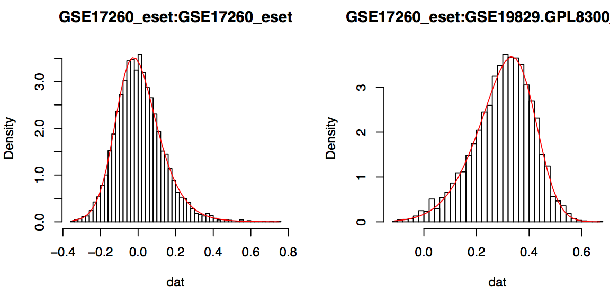
Duplicate profiles have unexpectedly high correlation to each other
Histograms showing Pearson correlation between all pairs of samples across two datasets.
These are duplicates between two Duke datasets. None of the others in these histograms are duplicates.

Slide 38
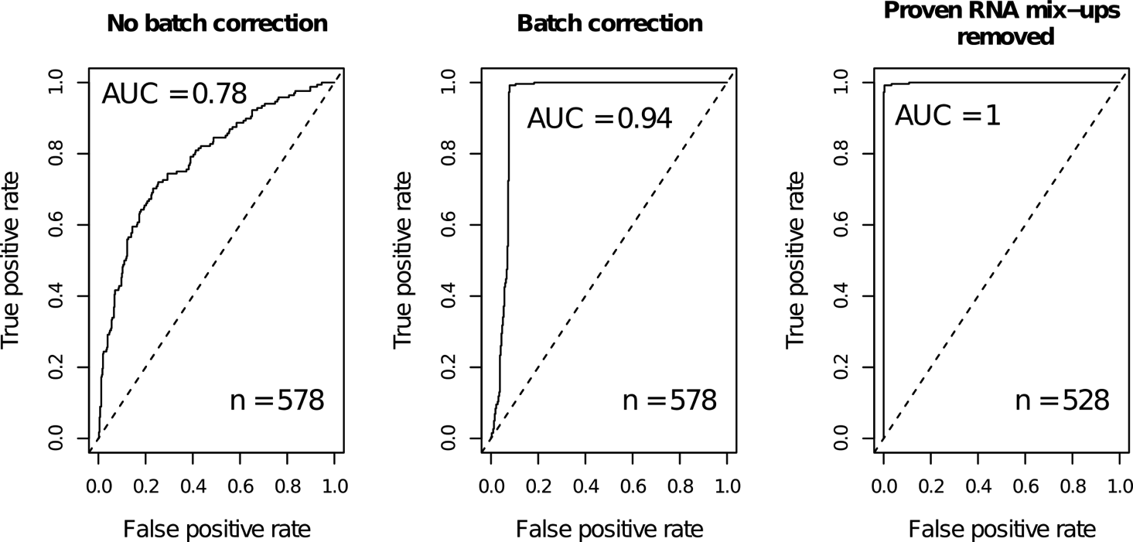
Matching microarray to RNA-seq profiles
The Cancer Genome Atlas ovarian cancer study
Matching Affymetrix microarray to RNA-seq profiles
Notes:
These ROC plots show the ability to match up microarray and RNA-seq profiles of OVC patients from TCGA. The first panel to the second shows that batch correction is an important step. The second to the third panel shows that most of the apparent errors made by doppelgangr were in fact errors in the labeling of TCGA samples. These were cases where Affymetrix microarrays were hybridized from the same patient twice, but recorded as being from two different patients. We figured this out first by noticing doppelgangers within the Affymetrix dataset, then confirmed it by comparing Affymetrix expression profiles to the Agilent microarray dataset and to copy number.

Slide 39
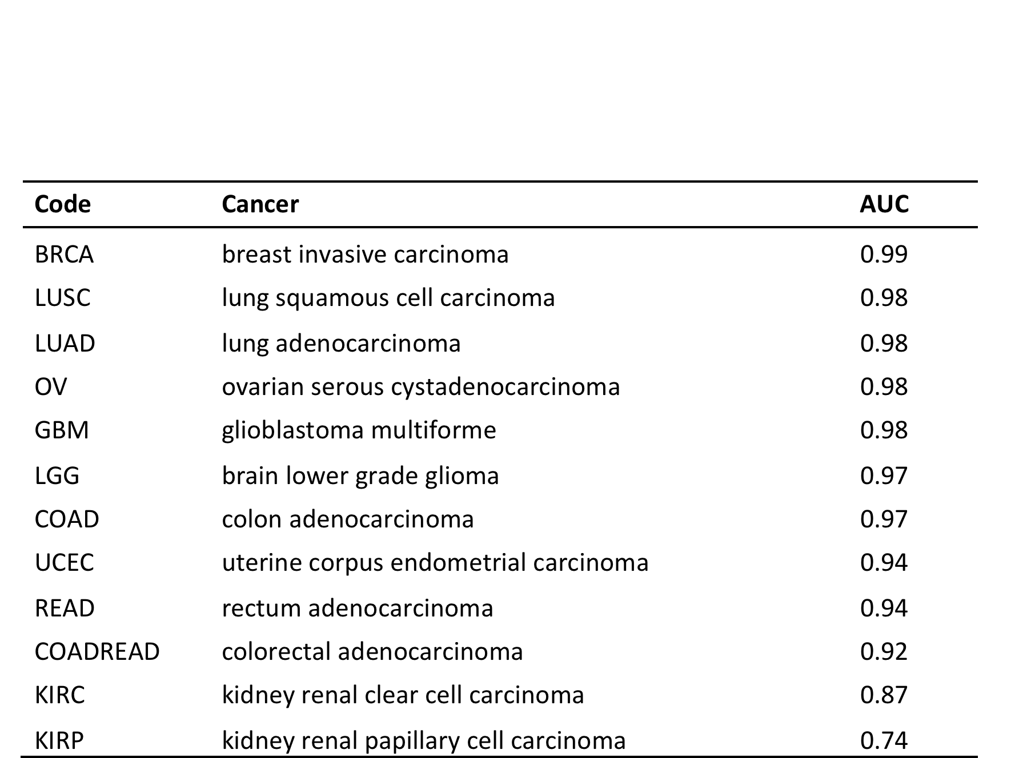
Matching microarray to RNA-seq profiles
For distinctive profiles, different technologies do not prevent duplicate identification
heavily re-arranged genomes
“quiet” genomes

Slide 40
On batch effects

Slide 41
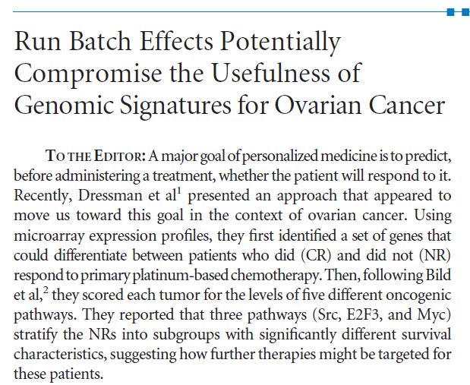
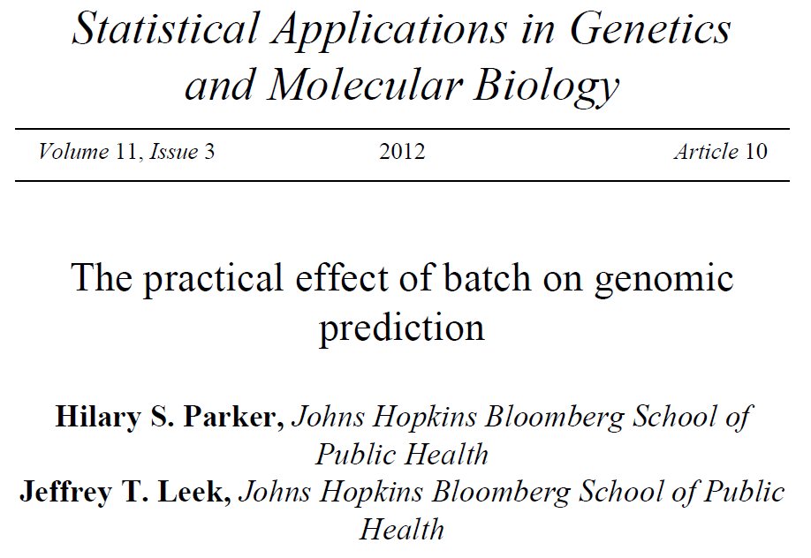
Batch effects as the enemy
Baggerly et al., JCO 2008
Notes:
Now I’m going to talk a bit more about ongoing analyses of these data, and by now you are probably familiar with the kinds of serious problems that batch effects can create for analysts of high-dimensional data.

Slide 42
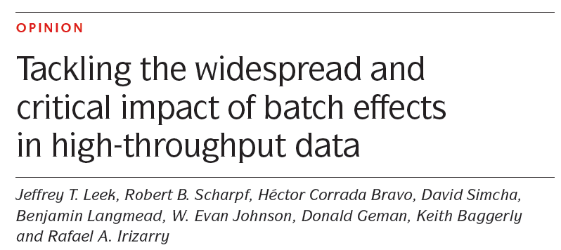
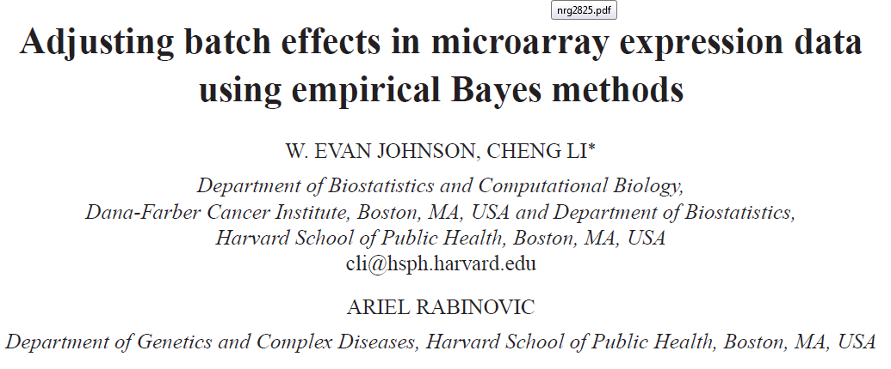
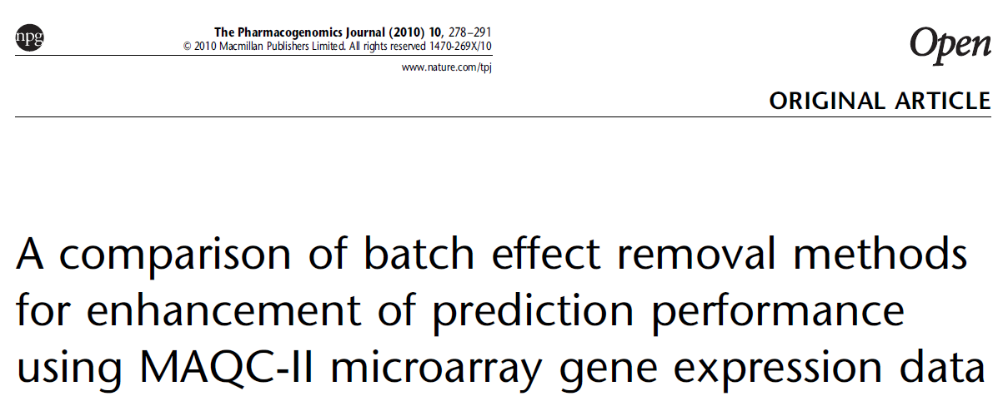
Mitigating the batch effect
Notes:
And with the useful tools that have been created to mitigate its effects,

Slide 43
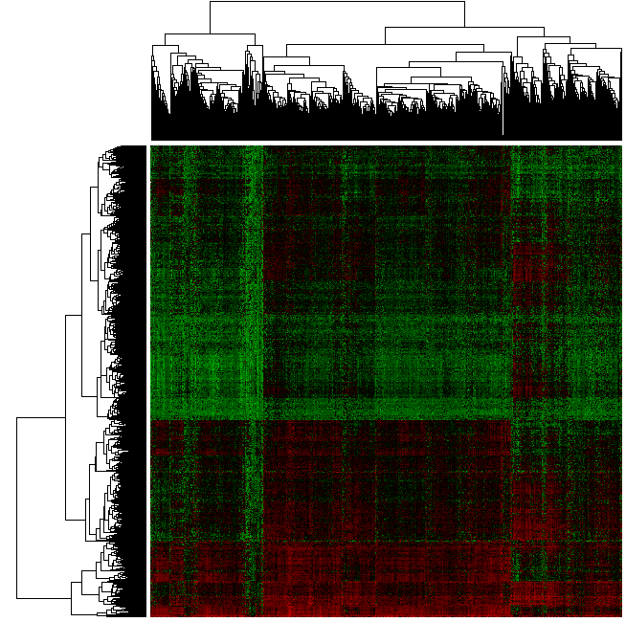
Accepting the batch effect
Batch-robust subtype discovery using multiple datasets
The problem with a single dataset:
Obvious subtypes?
Notes:
However in my experience, no matter how much quality control and batch correction you do in expression data from archival tissues, you cannot eliminate the batch effects. If your objective is unsupervised clustering to discover disease subtypes, you are especially vulnerable to batch effects – looking at a single dataset, it may appear to cluster nicely, but you cannot be sure of what is a batch effect and what is a true subtype.

Slide 44
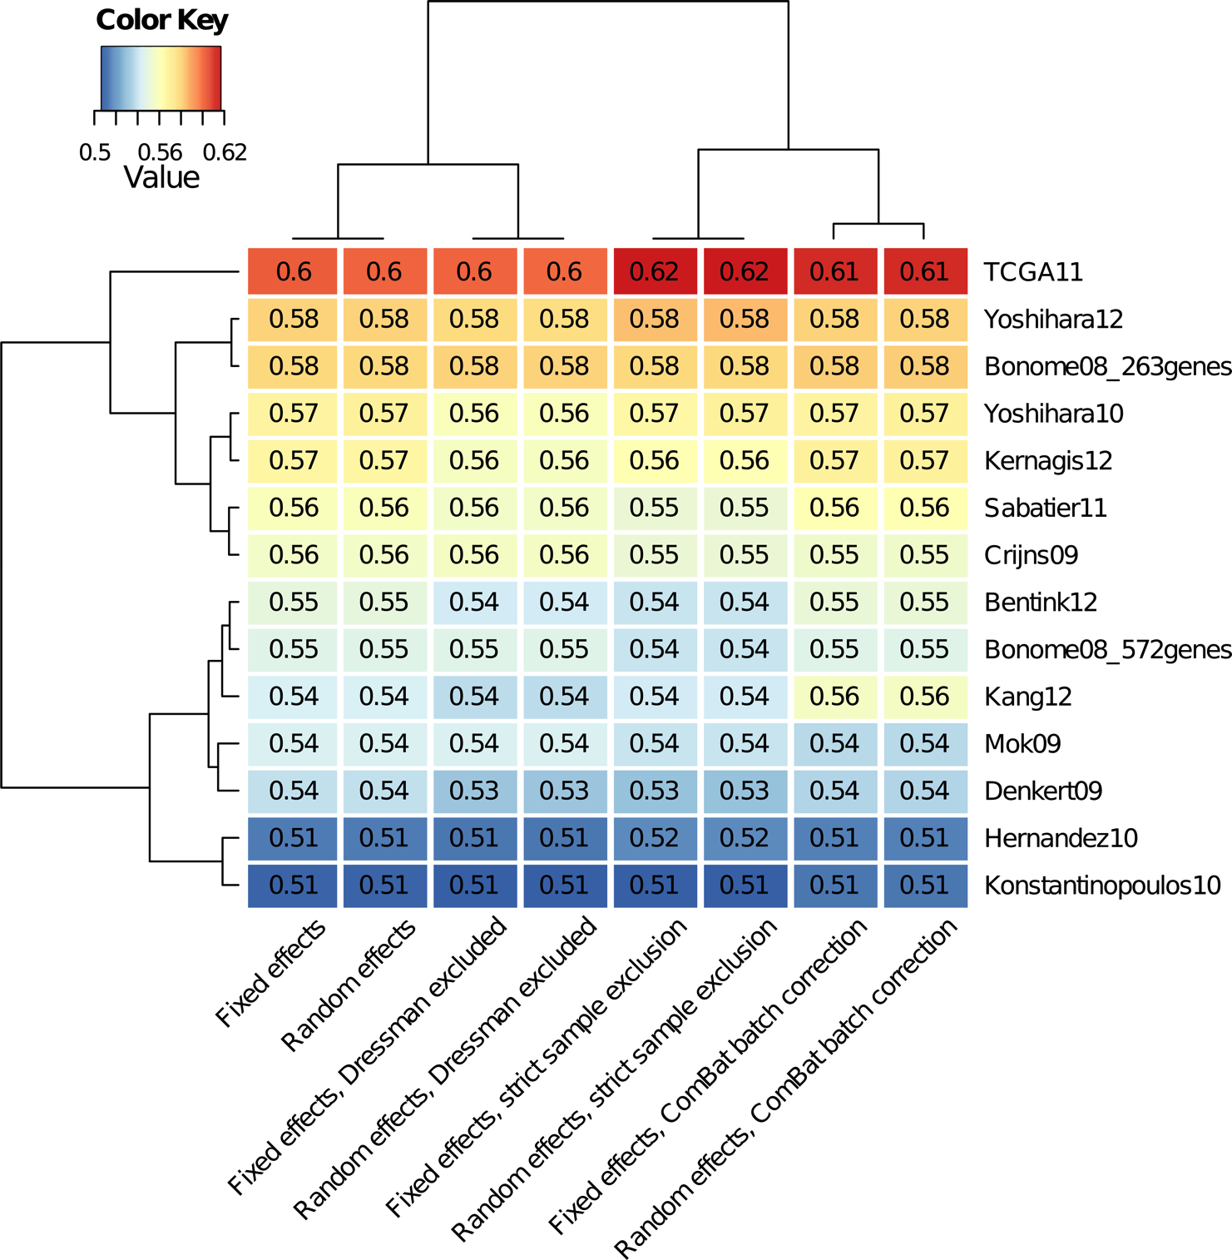
Heterogeneity not a major factor in comparative meta-analysis
Heatmap shows C-Index for survival association of risk models, synthesized across 10 datasets by 8 different methods.
Waldron L et al. JNCI J Natl Cancer Inst 2014;jnci.dju049

Slide 45
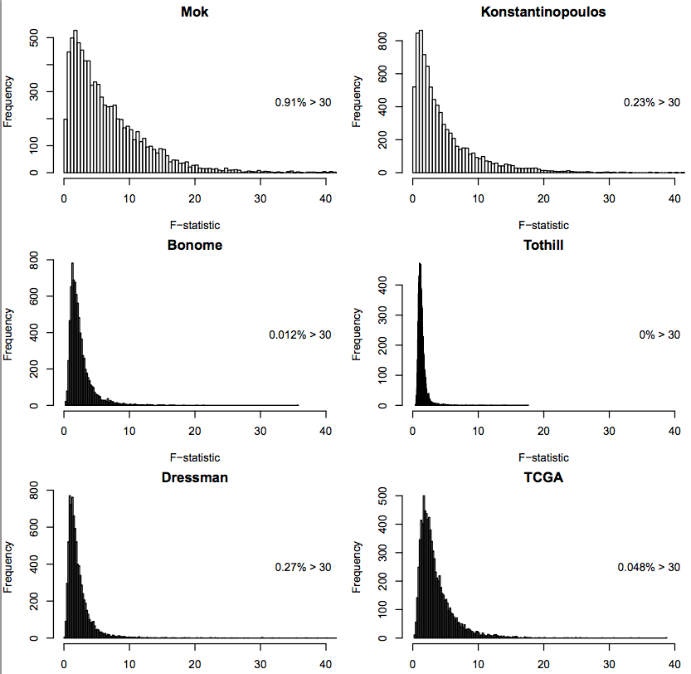
Magnitude of batch effect is not as important as confounding
Histograms shows F-statistic for ANOVA between expression and batch for each gene
The most important batch effects seen were the smallest

Slide 46
Accepting the batch effect: meta-analysis at its best
Use numerous independent datasets to find the common signal
Think of heterogeneity as an asset
Different technological platforms, laboratory methods, patient cohorts, make a common signal less likely to be an artifact
Leverage heterogeneity to identify the factors affecting the signal you see
Notes:
For this reason, in my efforts to identify subtypes of colorectal cancer in an unsupervised manner, I’ve looked for ways to use published datasets to support the effort. I am currently using 7 large published expression datasets from fresh-frozen tissues, plus our FFPE dataset. It’s worth noting that these originate from different technologies, and for my purposes and the method I’m proposing to use these, I actually consider that an asset rather than a problem. <click> The idea is to perform a PCA in each dataset <click> then to look for loadings vectors that are correlated across independent studies, and in this way build a network of correlated components.

Slide 47
Value of Publicly Available Data
Advances knowledge faster than private data
Encourages creative re-use of data
Data are generated before optimal analytic methods are available
Whole body of data can be greater than the parts
Why spend tremendous resources to generate “disposable” datasets
Peer-review of data, reproducible research

Slide 48
Challenges to utilizing publicly available data
Often not user friendly
Difficulties in identifying appropriate variables
Lengthy / incomplete / machine-unfriendly codebooks
Accessing data is complicated
Data is often distributed in specialized formats not directly analyzable
Creates a need for curation by bioinformaticists

Slide 49
Thank you
Lab members:
Post-doctoral fellow: Lavanya Kannan
Research Associates: Marcel Ramos, Lucas Schiffer, Rimsha Azar
MPH students: Tiffany Chan, Jamie Wood, Peter Chernek, Hanish Kodali
Undergraduate interns: Patrick Dorante, Warner Alexis
Collaborators
Nicola Segata, Alessandro Quattrone (UNITN)
Benjamin Haibe Kains (University of Toronto)
Giovanni Parmigiani (Dana-Farber Cancer Institute)
Michael Birrer (Massachusetts General Hospital)
Bioconductor: Martin Morgan, Vincent Carey, Kasper Hansen, multi-omics interest group.
Statistical Learning Book Club:
Currently reading “Data Analysis for the Life Sciences” by Irizarry and Love

Slide 51
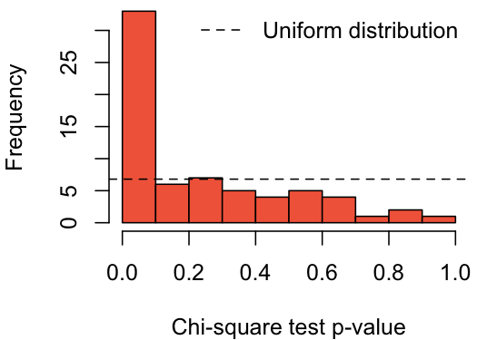
Chronology of subtype evolution
Evidence of association between focal copy number alterations and subtypes.
Data source: TCGA
A high proportion of CNA are associated with subtypes

Slide 52
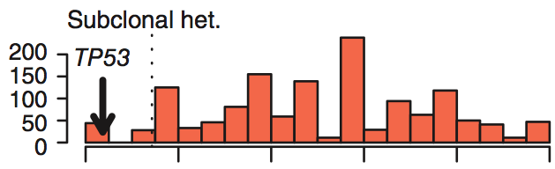
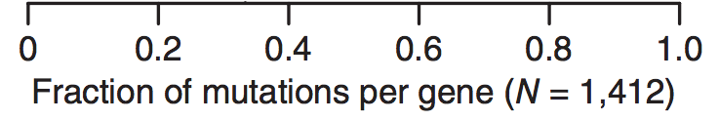
Chronology of subtype evolution
Subclonal heterogeneity of 1,412 genes as calculated by Carter et al. (2012).
Subclonal heterogeneity is defined as the fraction of samples in which mutations of that gene were inferred to be subclone-specific.

Slide 53
Chronology of subtype evolution
If subtype-associated alterations display less subclonal heterogeneity than others:
subtypes are early events, consistent with these being “intrinsic” subtypes.
If subtype-associated alterations display more sub-clonal heterogeneity than others:
subtypes are late events in tumor evolution.

